Slide 1
GLOBAL PRESENCE
Montreal / CA
Berlin / DE
QUEBEC / CA
London / UK
Nuremberg / DE
Chicago / US
Toronto / CA
Chester / UK
San Francisco / US
Lille / FR
Odessa, Ivano-Frankivsk, Chernivtsi / UA
Seoul / KR
Irving / US
Boston / US
Paris / FR
Bucharest, Cluj-Napoca, Brasov, Suceava, Iasi, Pitesti, Craiova, Piatra-Neamt / RO
Tokyo / JP
New York / US
Madrid / ES
Barcelona / ES
Izmir / TR
Sofia / BG
Ahmadabad / IN
San Diego / US
Austin / US
Osaka / JP
Karachi / PK
Shanghai / CN
Vietnam / VT
Fortaleza / BR
New Delhi / IN
Bogota / CO
Bangalore / IN
Phnom Penh / KH
Lima / PE
Quixada / BR
Singapore / SG
São Paulo / BR
Wellington / NZ
Brisbane / AUS
Auckland / NZ
Rio de Janeiro / BR
Adelaide / AUS
Porto Alegre / BR
Perth / AUS
Melbourne / AUS
Sydney / AUS
osf.digital
OSF Headquarters
OSF Offices
OSF Global Partners

Slide 2
WHO RECOMMENDS US
osf.digital
Notes:
We are lucky to work with such recognized brands

Slide 3
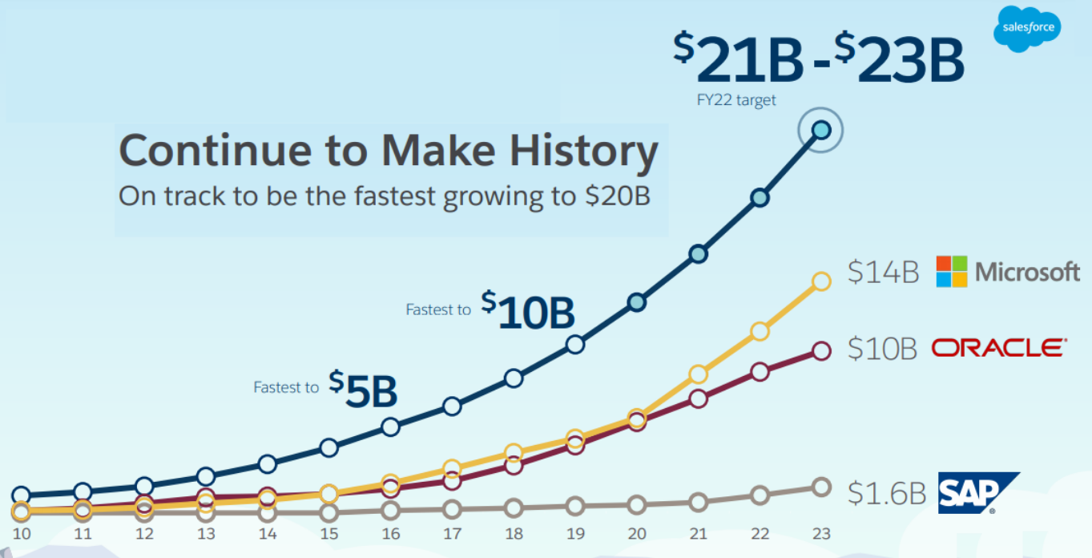
SALESFORCE
THE LEADER IN ENTERPRISE SOFTWARE SUITE
osf.digital
Notes:
Salesforce estimated growth is the highest of all the SaaS CRM Companies such as SAP Oracle and Microsoft.

Slide 4
New Company Values
osf.digital
Notes:
Our values drive everything we do at OSF Digital

